Slide 1

Creating J.A.R.V.I.S.

Slide 2
Creating J.A.R.V.I.S.
An Awesome Guide To Automating Your Home
By Scott Preston

Slide 4
About Me
Live in Columbus, Ohio.
Been doing robotics for last 15 years
Wrote a few books on robotics and mobile/js/html5.
Practice Lead at ICC focusing on JavaScript
Robotics Talks: COJUG, CRB, CodeMash, Ohio Linux

Slide 5
What’s J.A.R.V.I.S. stand for?

Slide 6
J.A.R.V.I.S.
J – Just
A – A
R – Rather
V – Very
I – Intelligent
S - System

Slide 7
About J.A.R.V.I.S.
Ubuntu Server 14.04
Core i5 / 16GB Ram / 240GB SSD
1GB Ethernet / 1 Bluetooth
4 USB Serial Ports
6 Slave Raspberry PIs w/LIRC & Temp Sensors
9 Network Cameras
1 Windows Machine for Skype
@jarvispreston (Twitter Handle)

Slide 8
How did I get here?

Slide 9

Summer 2008

Slide 10
Initial Goals
Turn lights on/off Sunrise / Sunset
Wake me up with weather report

Slide 11
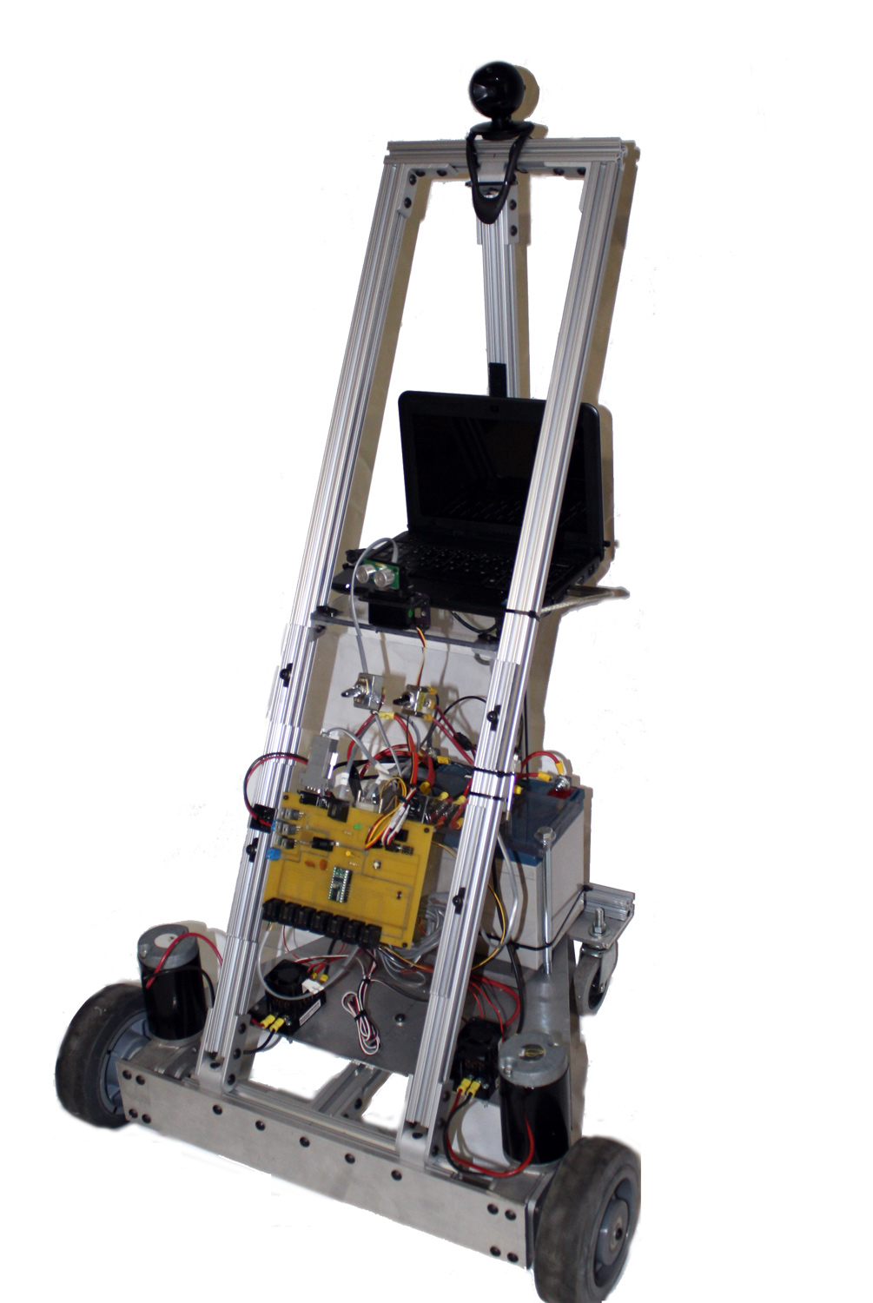
I had an old robot (JR-MK2)

Slide 12
Robot Had 2 Parts I needed
Basic Stamp & Distribution Board
Serial Servo Controller

Slide 13
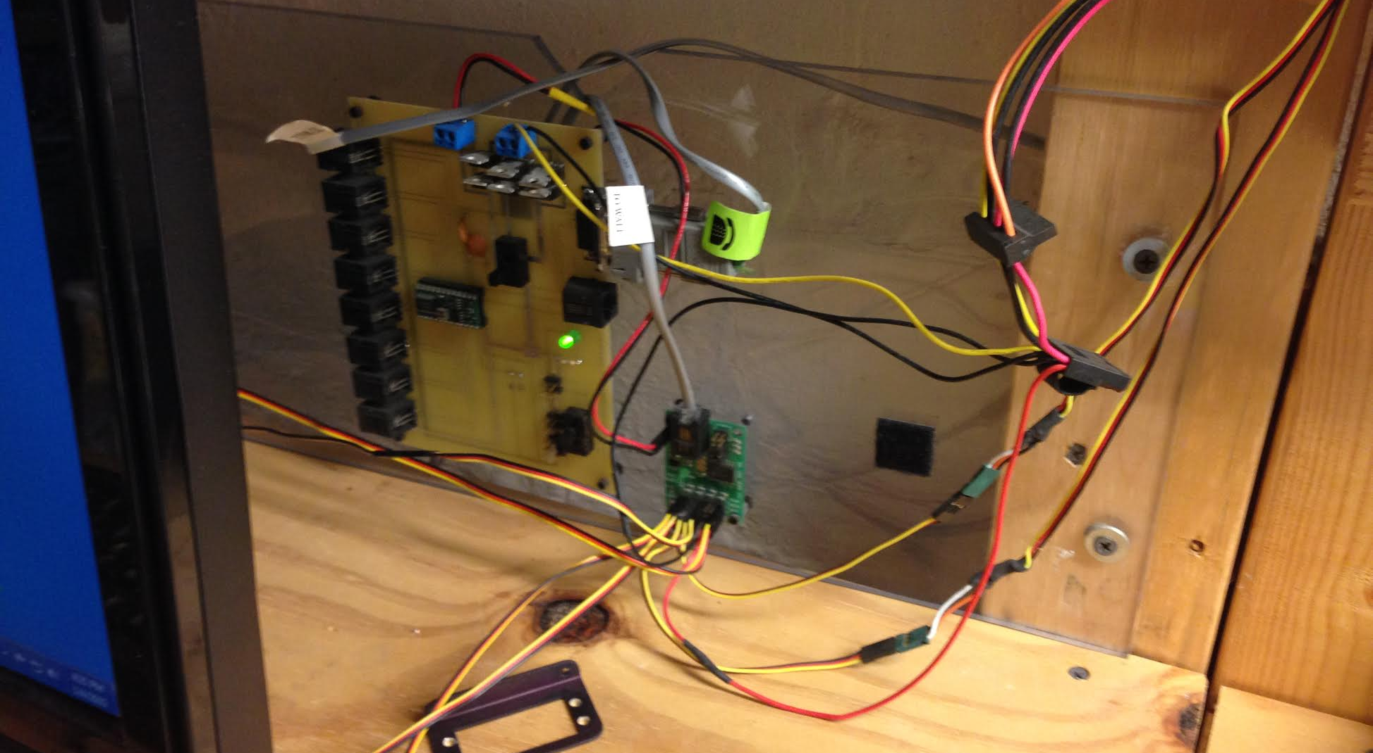
Stamp & Controller Board

Slide 14
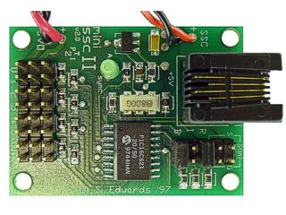
SSC

Slide 15
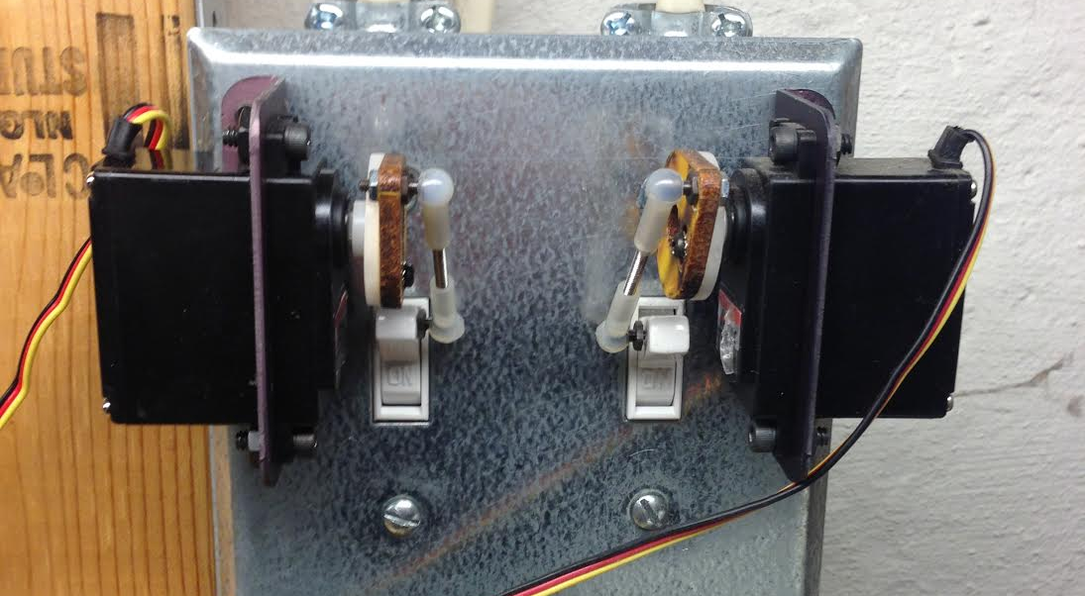
Before X10 ~ $7 Switch

Slide 16
Used SSC (Still Used)
Lights On
http://192.168.1.60:8001/?pin=2&pos=200
http://192.168.1.60:8001/?pin=3&pos=70
Lights Off
http://192.168.1.60:8001/?pin=2&pos=127
http://192.168.1.60:8001/?pin=3&pos=127

Slide 17
X10 – External Lights

Slide 18
What’s X10?
Developed in 1975 by Pico Electronics (Scotland)
Digital Carrier transmitted onto a 120hz carrier existing power lines.
Limitations – GCFI Outlets, Older Technology, Reliability, # of Devices
Pros – Cheap, Nothing else around in 2008, Microcontrollers have built-in support

Slide 19
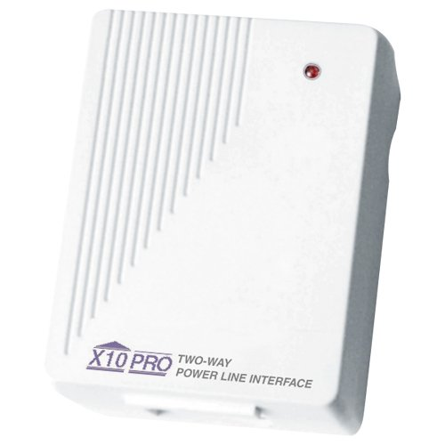
X10 – TW523 Interface~$60-$80

Slide 20
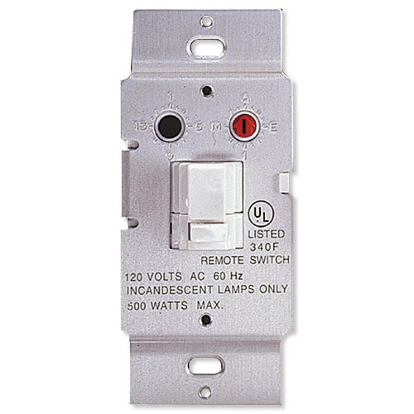
X10 – WS467 $16.99

Slide 21
X10 – Protocol (via BS2)
XOUT mPin, zPin, [houseCode\unitCode]
XOUT mPin, xPin, [houseCode\onORoff]
houseCode = 1-16
unitCode = 1-16
onORoff = 0, 1

Slide 22
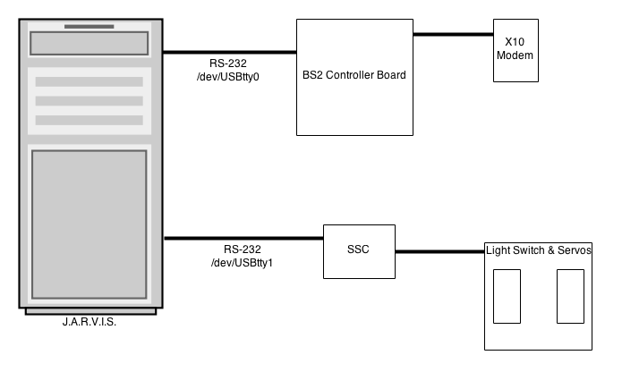
Initial Layout

Slide 23
Node Set-Up
npm install serial-port (Serial Ports)
npm install serial-servo (Serial Servo Controllers)

Slide 24
X10.js – SerialPort
var http = require('http');
var url = require('url');
var port = 8000;
var usbport = "/dev/ttyUSB0";
var SerialPort = require("serialport").SerialPort;
var sp = new SerialPort(usbport, {
baudrate: 9600
});
Serial Port Setup

Slide 25
X10.js – Server Code
var server = http.createServer(function (request, response) {
var url_parts = url.parse(request.url, true);
var house = url_parts.query.house;
var device = url_parts.query.device;
var onoff = url_parts.query.onoff;
write(house,device,onoff);
});
Http Parms to Serial Port

Slide 26
X10.js – Serial Writing
function write(house, device, onoff) {
if (house >= 0 && device >= 0 && onoff >= 0) {
var b = [100, house, device, onoff];
sp.write(b);
}
}
Byte[] sent to serial port

Slide 27
Sunrise & Sunset
http://api.wunderground.com/api/USER_KEY/astronomy/q/43212.json
Gets sun-rise
Gets sun-set
CRON runs each minute and checks for time match

Slide 28
Weather Underground – REST API
http://api.wunderground.com/api/USER_KEY/conditions/q/43212.json
Schedule Via CRON (hourly)
Populate to database via wrapper.

Slide 29
Putting It All Together
Old Robot Parts w/Serial & X10
X10 Switches
Weather Underground w/Sunrise & Sunset Data
CRON Scheduler
Results: Robot that can turn on/off lights for me.
Missing: Text-To-Speech (later)

Slide 30
More Devices
Since X10 is 40 years old

Slide 31
Kinds Of Devices (non-X10)
Proprietary (Lots of these) – On their own
Wifi – Many devices, limited APIs & Smart Phones
BLE – Blue Tooth Low Energy (Smart Phone Only)
Z-Wave – Need Interface (Wireless)
Insteon – Need Interface module Wireless + X10

Slide 32
Kinds Of Devices (non-X10)
Proprietary (Lots of these) – On their own
Wifi – Many devices, limited APIs & Smart Phones
BLE – Blue Tooth Low Energy (Smart Phone Only)
Z-Wave – Need Interface (Wireless)
Insteon – Need Interface module Wireless + X10

Slide 33
Kinds Of Devices (non-X10)
Proprietary (Lots of these) – On their own
Wifi – Many devices, limited APIs & Smart Phones
BLE – Blue Tooth Low Energy (Smart Phone Only)
Z-Wave – Need Interface (Wireless)
Insteon – Need Interface module Wireless + X10

Slide 34
Kinds Of Devices (non-X10)
Proprietary (Lots of these) – On their own
Wifi – Many devices, limited APIs & Smart Phones
BLE – Blue Tooth Low Energy (Smart Phone Only)
Z-Wave – Need Interface (Wireless)
Insteon – Need Interface module Wireless + X10

Slide 35
Kinds Of Devices (non-X10)
Proprietary (Lots of these) – On their own
Wifi – Many devices, limited APIs & Smart Phones
BLE – Blue Tooth Low Energy (Smart Phone Only)
Z-Wave – Need Interface (Wireless)
Insteon – Need Interface module Wireless + X10

Slide 36
Device Types
Controllers/Hubs
Locks
Thermostats
Sensors
Lights
Switches
Smart Meters

Slide 37
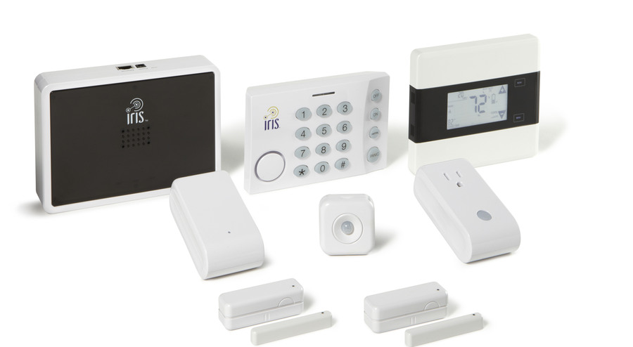
Proprietary - IRIS by Lowes
Some devices Z-Wave Compatible!

Slide 38
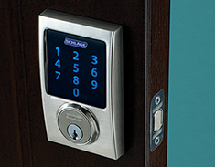
Schlage Z-wave Lock

Slide 39
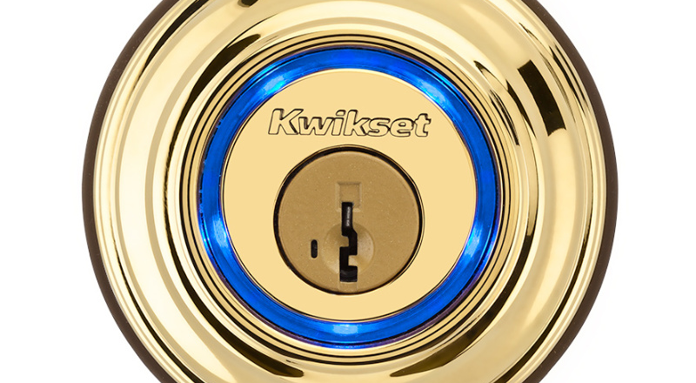
KEVO – Bluetooth LE (Not Z-Wave)

Slide 40

Kwickset – Z-Wave

Slide 41
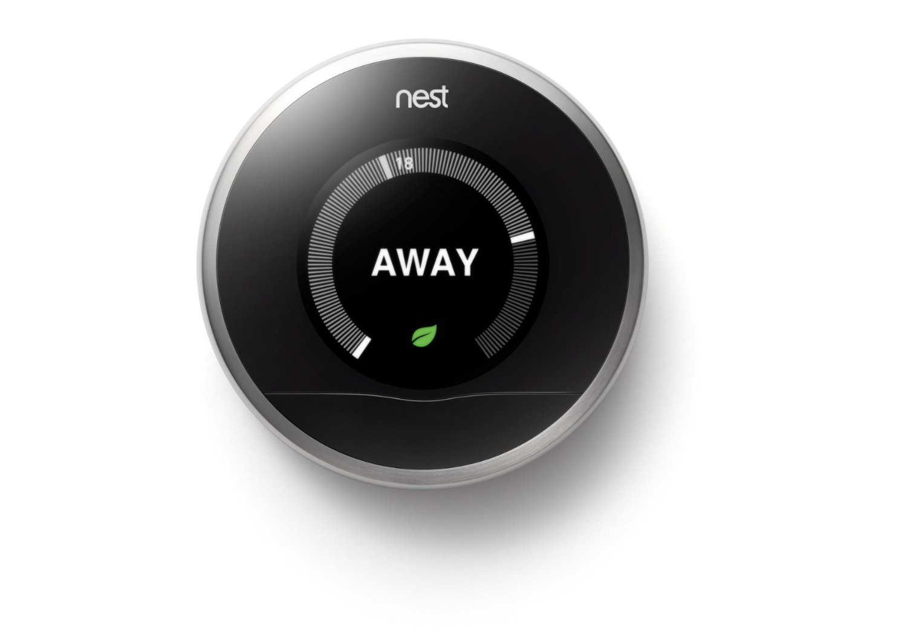
nest Thermostat ($250)
REST API available from nest and full SDK.

Slide 42
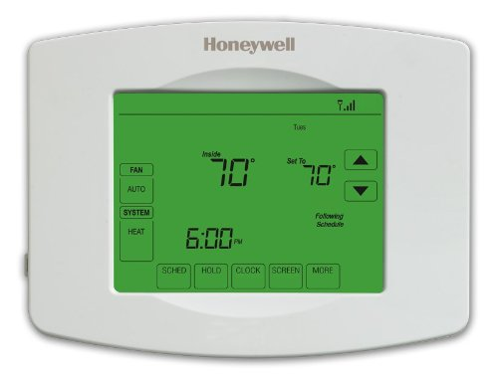
Z-Wave + WiFi ~$75 to $200

Slide 43
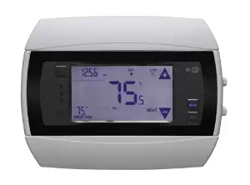
Radio Thermostat ~$100 with REST API from Amazon.Com

Slide 44

Aeon Labs – Z-Wave Switch

Slide 45
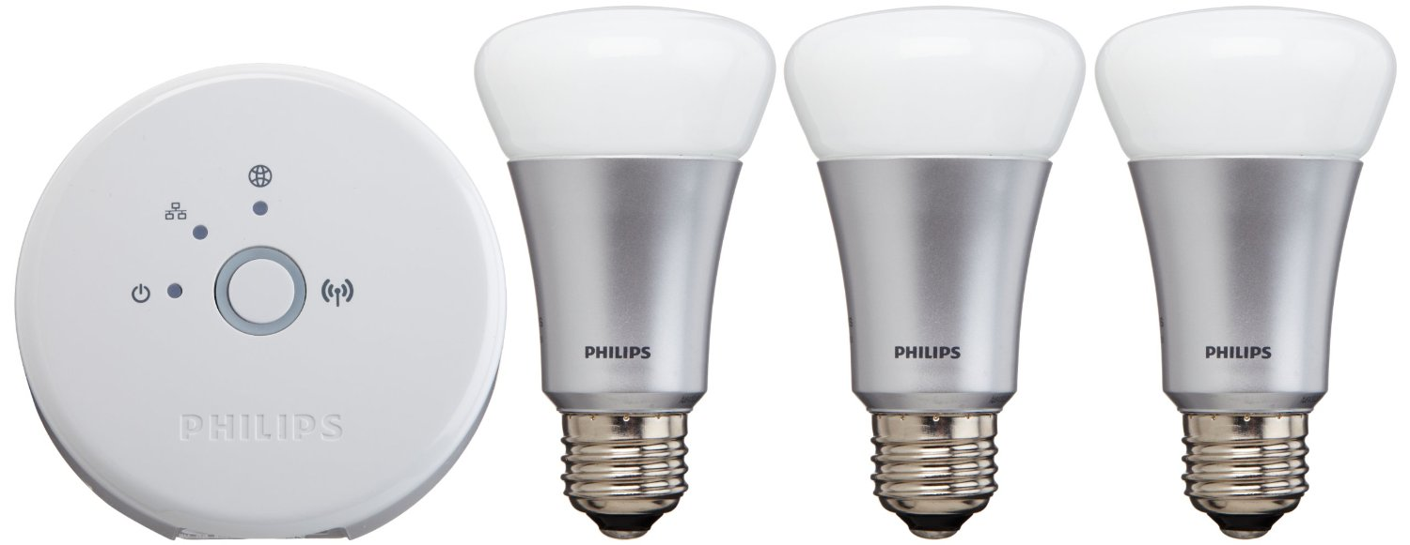
Phillips Hue (Zigbee & Ethernet)
http://www.developers.meethue.com/tools-and-sdks

Slide 46

WeMo – WiFi Switch
Many NPM modules available to use.

Slide 47

Z-Wave Flood Sensor

Slide 48
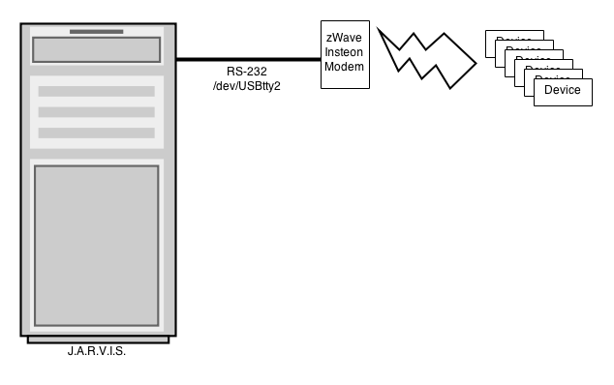
Z-wave Interfacing

Slide 49
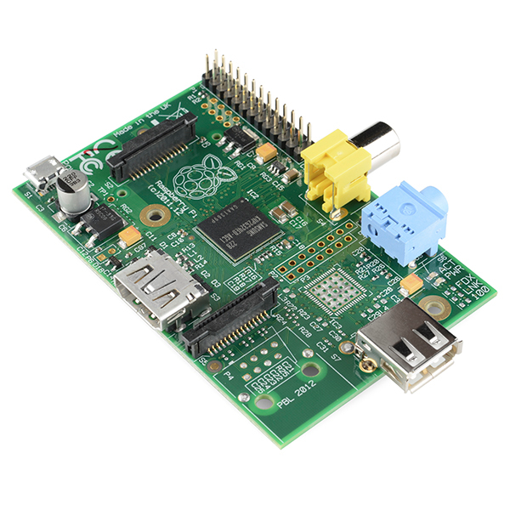
Raspberry Pi ~ $30

Slide 50
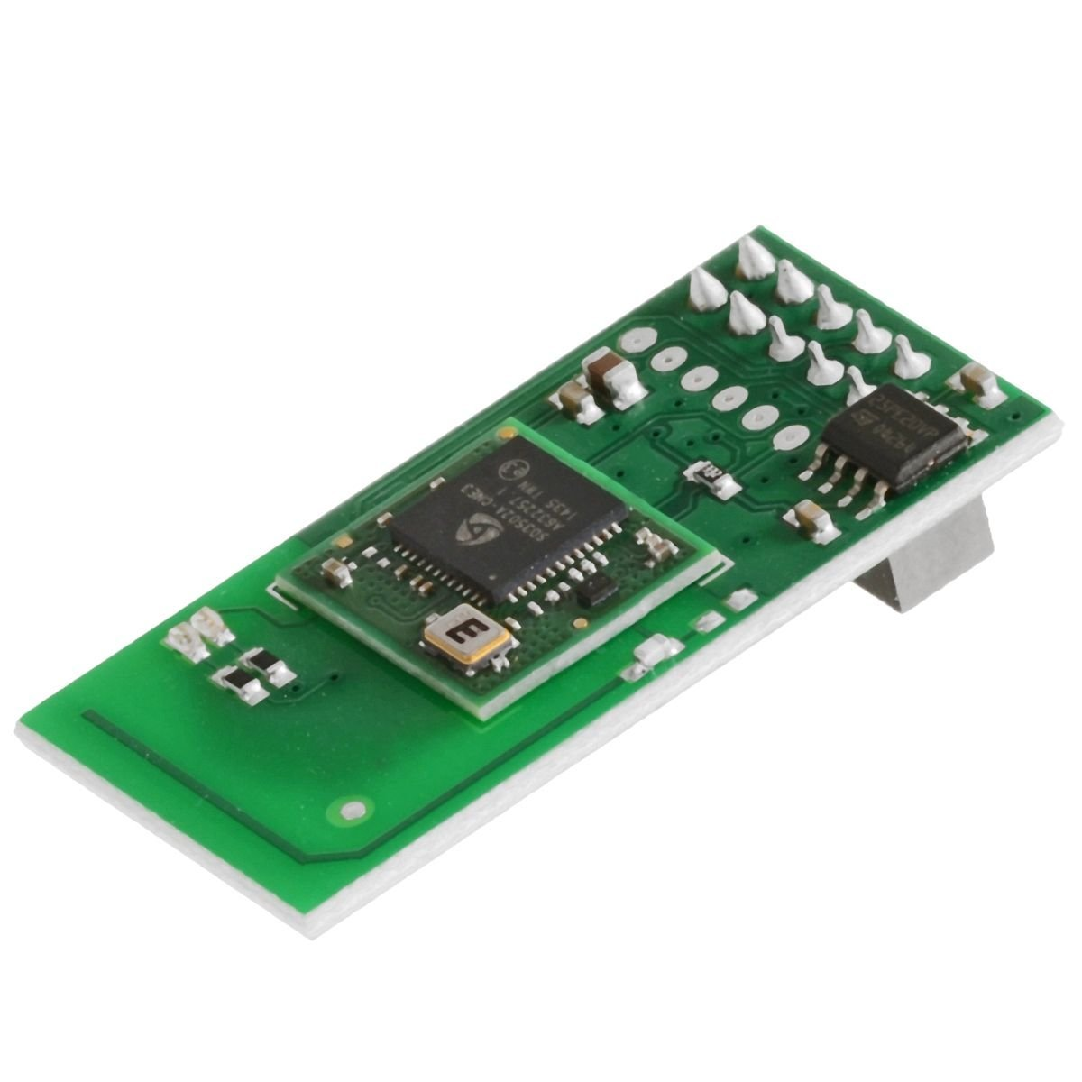
Z-Wave GPIO Daughter Card - $60
http://razberry.z-wave.me/

Slide 51
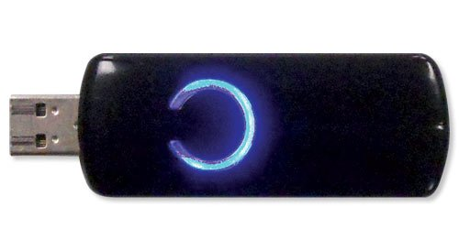
Z-Wave USB ~$40
Google ‘openzwave’ for npm modules.

Slide 52
How close are we to J.A.R.V.I.S.?

Slide 53
J.A.R.V.I.S.
Home Sensors
Home Control (Lights/Blinds/Etc.)
Speech Recognition / Text-To-Speech
Computer Vision
TV / Stereo Control
Event Based System & Robot Control
3D Metal Printers

Slide 54
Speech Recognition
w/Sphinx4
Open Source Java Speech Recognition

Slide 55

Wrote this book in 2005.

Slide 56
Text To Speech
3rd Party Voice (Cepstral TTS)
Festival TTS (Free)
Linux command I’m using:
/usr/bin/padsp swift “words to speak”

Slide 57
Remote Text To Speech
swift "$1" -o tmp.wav // create wav
lame tmp.wav tmp.mp3 // convert to mp3
scp tmp.mp3 pi@10.10.10.32:tmp.mp3 // send
ssh pi@10.10.10.32 'mpg123 tmp.mp3' // play

Slide 58
Remote Text To Speech
swift "$1" -o tmp.wav // create wav
lame tmp.wav tmp.mp3 // convert to mp3
scp tmp.mp3 pi@10.10.10.32:tmp.mp3 // send
ssh pi@10.10.10.32 'mpg123 tmp.mp3' // play

Slide 59
Remote Text To Speech
swift "$1" -o tmp.wav // create wav
lame tmp.wav tmp.mp3 // convert to mp3
scp tmp.mp3 pi@10.10.10.32:tmp.mp3 // send
ssh pi@10.10.10.32 'mpg123 tmp.mp3' // play

Slide 60
Remote Text To Speech
swift "$1" -o tmp.wav // create wav
lame tmp.wav tmp.mp3 // convert to mp3
scp tmp.mp3 pi@10.10.10.32:tmp.mp3 // send
ssh pi@10.10.10.32 'mpg123 tmp.mp3' // play

Slide 61
How do I talk to J.A.R.V.I.S.?
Microphone
Wireless Headset
Bluetooth
Skype via API?
Skype as Services??

Slide 62
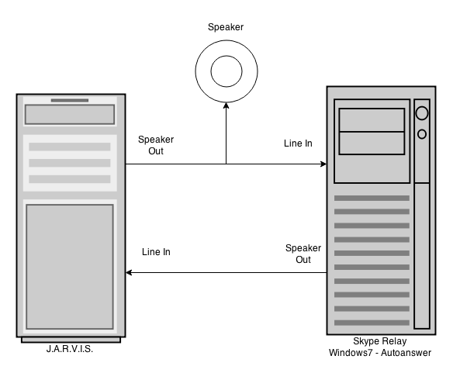
Skype As Service (low-tech)

Slide 63
Putting It all Together
Speech Recognition – Publishing Events
Text To Speech either via Speaker, Skype (Phone) or Remote Speaker
Tell J.A.R.V.I.S. to turn on lights and turn off lights

Slide 64
J.A.R.V.I.S Voice Demo

Slide 65
What Next?

Slide 66
Computer Vision
9 Network Cameras in Total
To Report Motion Detection Events
Each capable of doing face recognition (still debugging)
J.A.R.V.I.S. – Using Java based motion detection in multiple threads for each camera defined via UI
Table of Camera Stored in J.A.R.V.I.S Database

Slide 67

Foscam Pan/Tilt
Resolution 640x480 and 1280x720

Slide 68
Camera Parameters
Name
Snapshot_url for taking JPG image
Sample Frequency in milliseconds
Sensitivity
Top, Left, Height, Width
Notify URL / Event To Publish

Slide 69
Vision Summary
9 Cams Mapped To Location
J.A.R.V.I.S. monitors “motion” events and “face” events
Checks For Motion every 500ms to 2000ms
Face checks only if motion

Slide 70
TV / Stereo Control
Device Might Have an API
LIRC w/Raspberry PI

Slide 71
DirecTV - Power On
http://192.168.1.99:8080/remote/processKey?key=poweron&hold=keyPress

Slide 72
DirecTV – Power Off
http://192.168.1.99:8080/remote/processKey?key=poweroff&hold=keyPress

Slide 73
DirecTV – Change Channel
http://192.168.1.99:8080/tv/tune?major=10

Slide 74
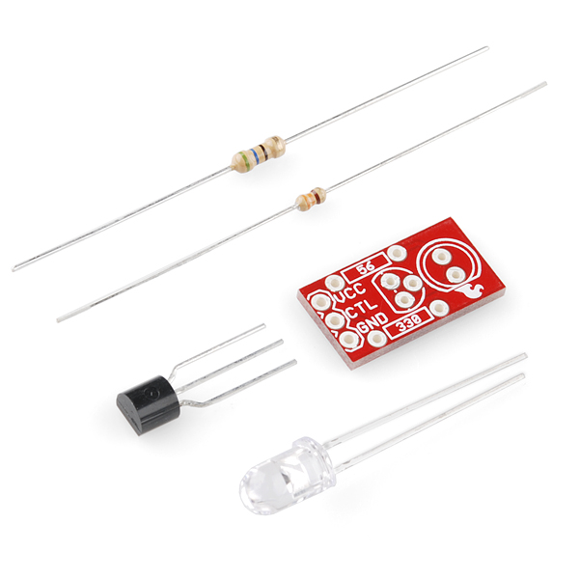
Sparkfun – Max Power LED $2.95

Slide 75
LIRC
Linux Infrared Remote Control - http://www.lirc.org/
apt-get install lirc
update /etc/modules
update /etc/lirc/hardware.conf
update /etc/lirc/lircd.conf

Slide 76
Invoking From Service
Use php exec(garage-power.sh)
#!/bin/bash ssh pi@10.10.10.32 'irsend SEND_ONCE yam POWER'
** Subscribe to STEREO_ON event, calls shell

Slide 77
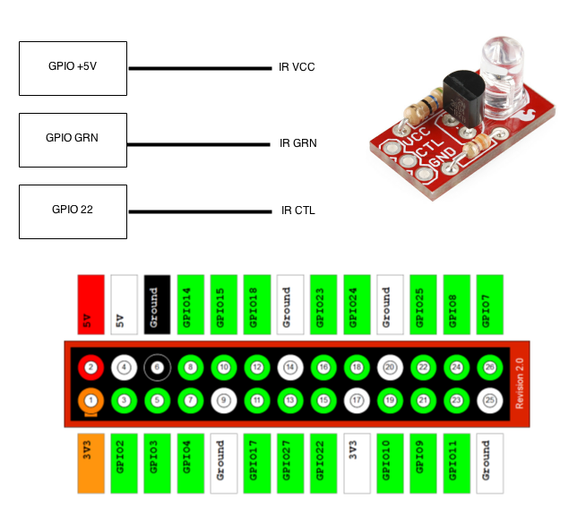
LIRC Diagram
Raspberry PI GPIO

Slide 78
lircd.conf
begin remote
name yam
bits 32
flags SPACE_ENC
eps 20
aeps 200
header 8800 4400
one 550 1650
zero 550 550
ptrail 550
repeat 8800 2200
gap 38500
toggle_bit 0
frequency 38000
begin codes
POWER 0x000000005EA1F807

Slide 79
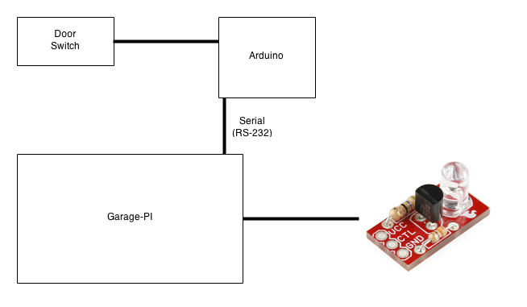
Garage Wiring Diagram

Slide 80
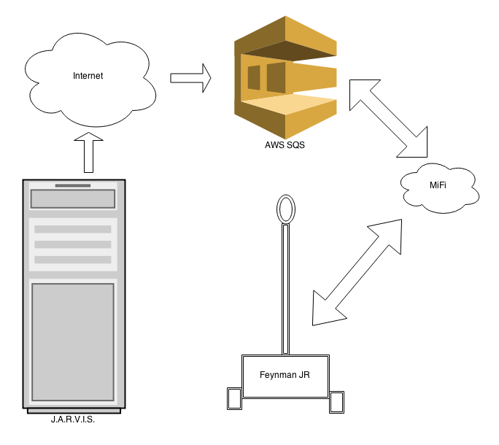
Non-Local Events - SQS

Slide 81
J.A.R.V.I.S & Feynman JR. DEMO

Slide 82

CodeMash 2.0.1.6.

Slide 83
Thank You
@scottpreston
Http://github.com/scottpreston

